Slide 1


Jun Lee
Jun Lee
My Works

Slide 2
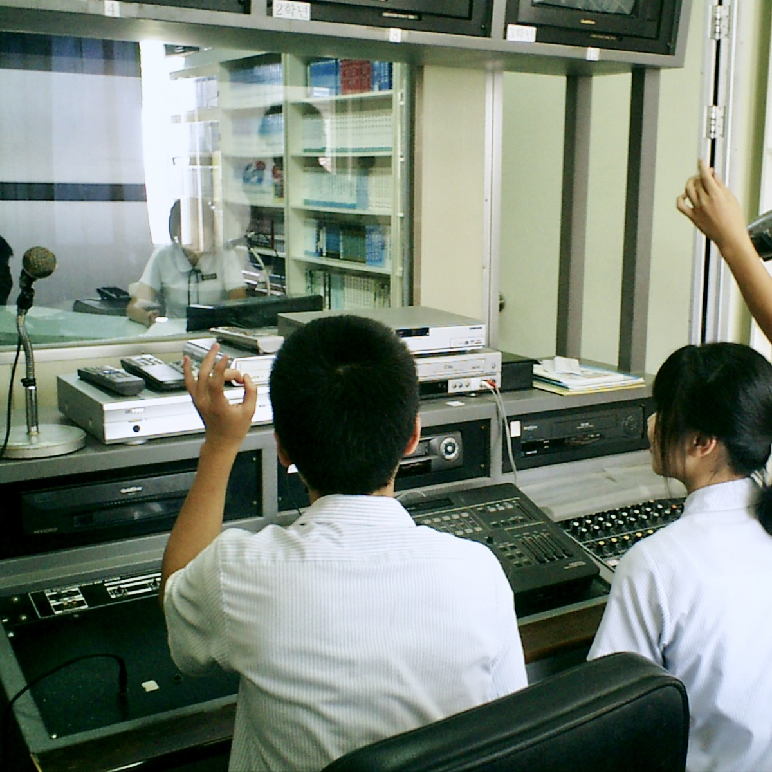
My Works
Broadcasting Club
Assisted with broadcasting and operated cameras for major school events such as festivals, entrance ceremonies, and graduations during high school.
Played student-requested music and delivered news during lunchtime broadcasts to all classrooms, improving communication and organizational skills.

Slide 3
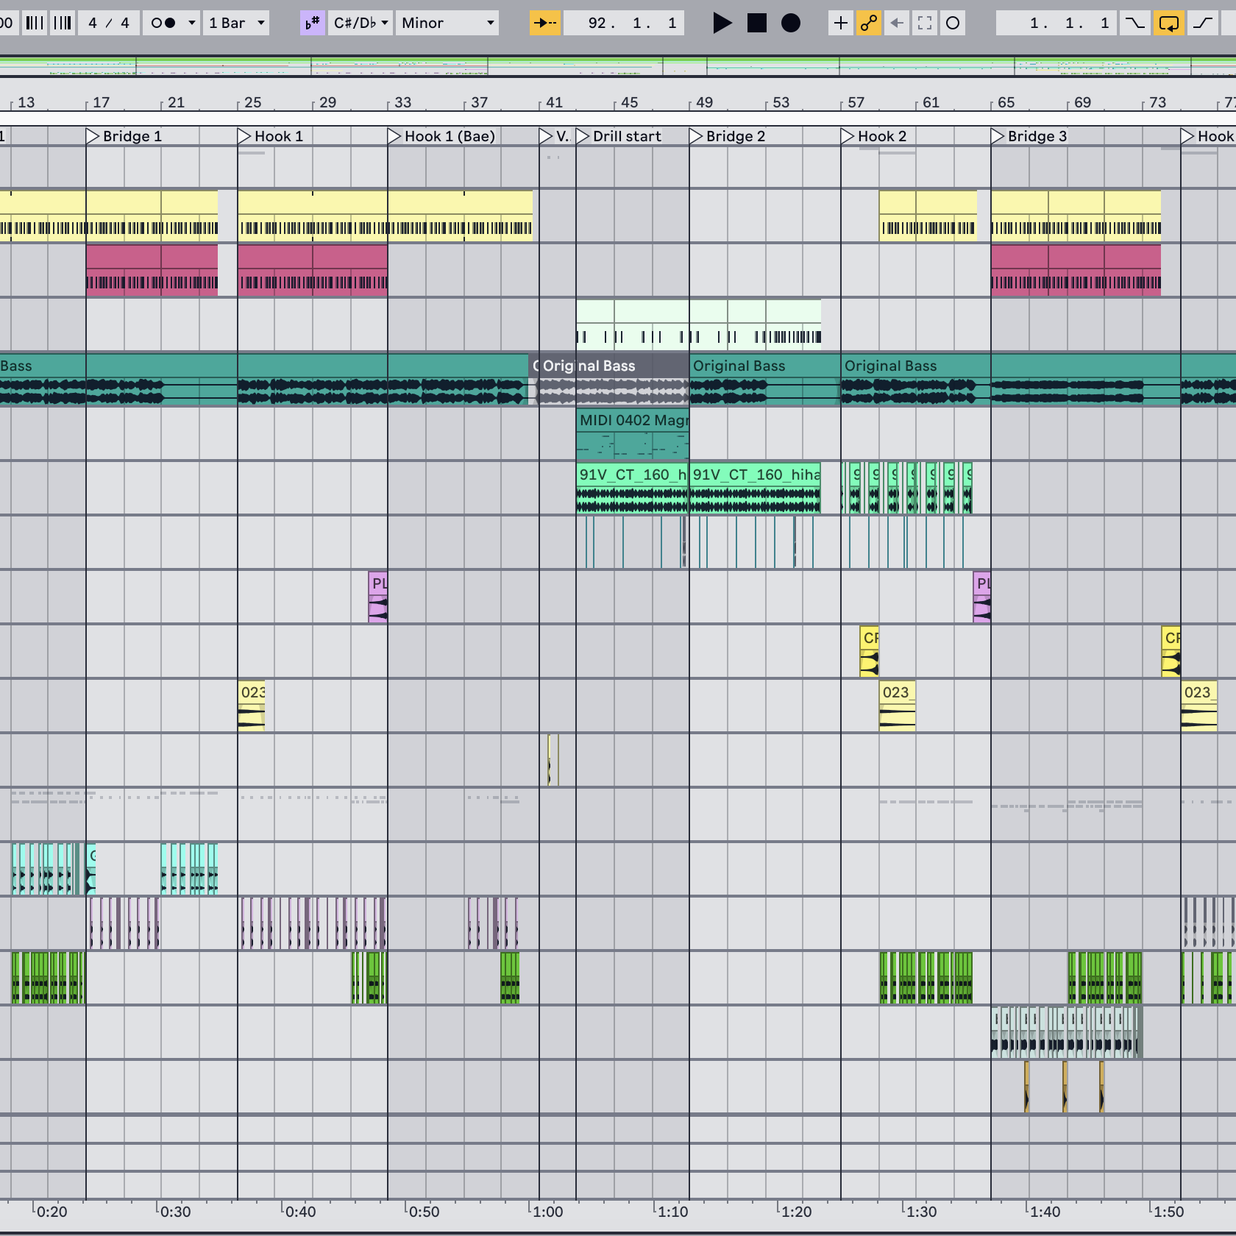
My Works
Music Composer
Composed music across various genres, including R&B and hip-hop, for personal projects.

Slide 4
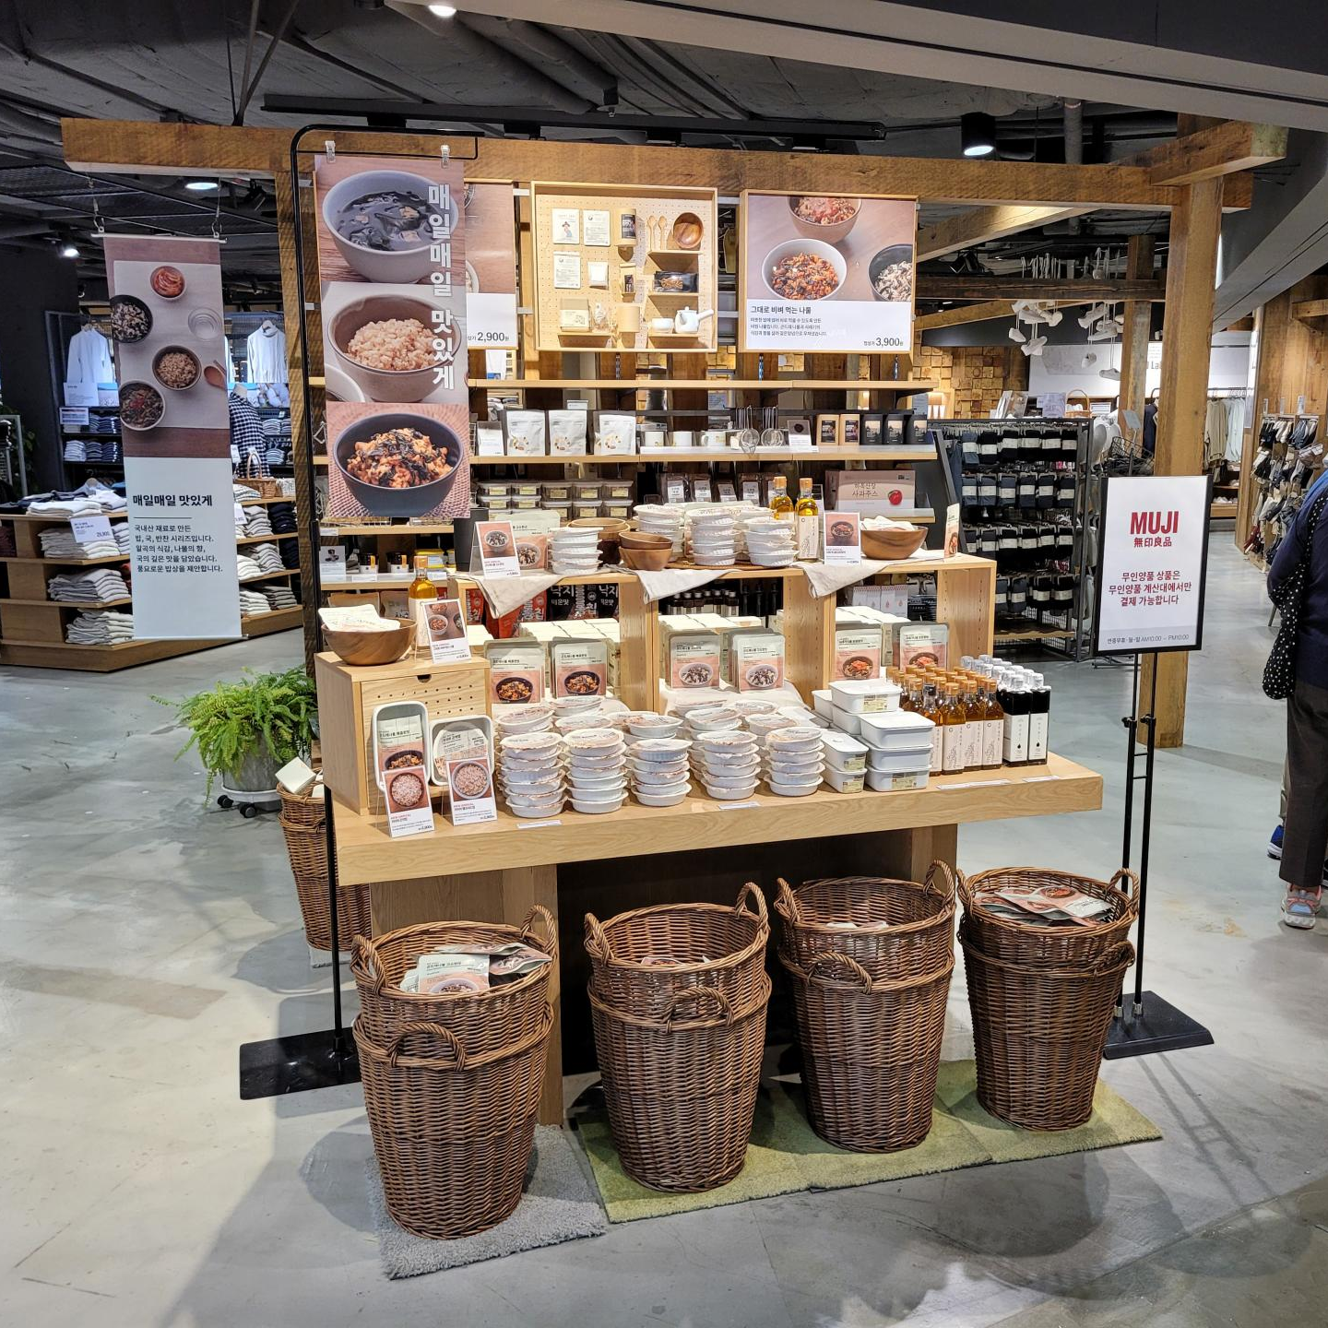
My Works
Retail Associate
Worked as a store associate for six months, ensuring a well-organized and visually appealing store environment.
Improved customer service skills by responding to customer inquiries, solving issues, and providing friendly and attentive support.

